Slide 1
Data Structures Workshop
Day 9

Slide 2
Exam Outline
Linked Lists (4 Questions → 34 Points)
Recursion (2 Questions → 22 Points)
Sorting (3 Questions → 24 Points)
Arrays (1 Question → 8 Points)
Time Complexity (2 Questions → 12 Points)

Slide 3
Exam Tips
If you don’t know the answer to a question immediately… MOVE ON
Don’t waste precious time when you could be working on other questions
You want to rack up as many points as you can
Partial credit is your best friend
Even if you don’t have the exact answer in mind, anything can be better than writing absolutely nothing
Ex. Recursion → At least write down a base case
Go over Extras/Workshop Examples
These questions have a chance of showing up on the exam in some capacity
Start studying now if you haven’t
I do not recommend cramming for any DSA exam

Slide 4
Workshop Outline
Linked Lists
Sorting Algorithms (Bubble Sort, Selection Sort, & Insertion Sort)

Slide 5
Linked Lists

Slide 6
What To Know
Know What Single, Doubly and Circular Linked Lists Are
Insertion
At at beginning, end, or middle (based on position or value)
Deletion
At at beginning, end, or middle (based on position or value)
Printing Content of a Linked List
Normally and Reversed
Any Linked List Implementation Covered in Workshop
Look at past workshop slides
Theory

Slide 7
Sorting Algorithms

Slide 8
What To Know
Algorithm Implementations
Bubble Sort (v1 and v2)
Selection Sort
Insertion Sort
Trace Algorithms
Show Each Pass on Given Array of Unsorted Elements Until Sorted
Good Resource: https://visualgo.net/en/sorting
Time Complexities
Worst and Best Cases For Each Algorithm

Slide 9
Bubble Sort
Compares two adjacent elements and swaps them until they are in the intended order
Time Complexity
Best: O(n) → assumes v2 and array is already sorted
Worst: O(n^2)
Know v1 and v2

Slide 10
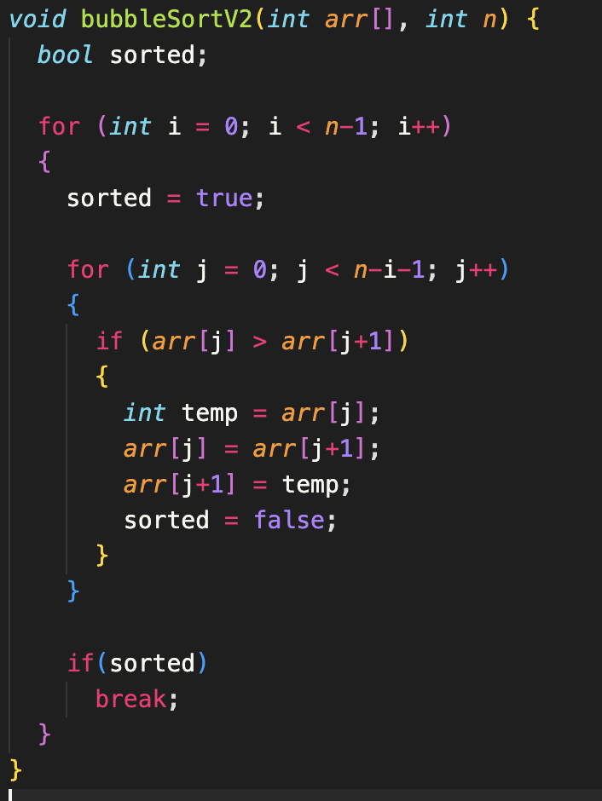
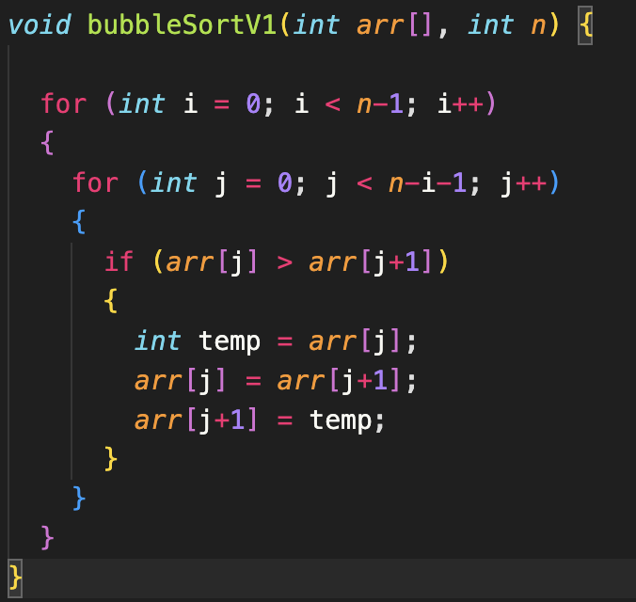
Bubble Sort Implementation

Slide 11
Bubble Sort Tracing
Manually sort the following array using Bubble Sort (show each pass):
[10, 3, 9, 7, 24, 2]
Pass 1: [3, 9, 7, 10, 2, 24]
Pass 4: [3, 2, 7, 9, 10, 24]
Pass 2: [3, 7, 9, 2, 10, 24]
Pass 5: [2, 3, 7, 9, 10, 24]
Pass 3: [3, 7, 2, 9, 10, 24]

Slide 12
Selection Sort
An algorithm that chooses the smallest element in an unordered array in each iteration and places that element at the beginning of the unsorted array
Time Complexity:
Best: O(n^2)
Worst: O(n^2)

Slide 13
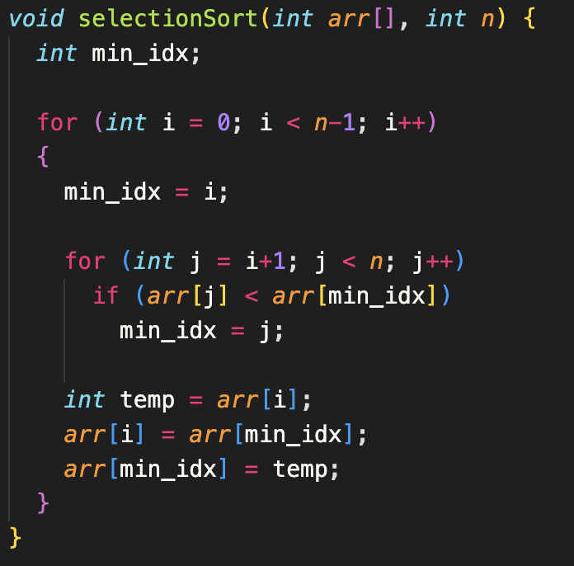
Selection Sort Implementation

Slide 14
Selection Sort Tracing
Manually sort the following array using Selection Sort (show each pass):
[10, 3, 9, 7, 24, 2]
Pass 1: [2, 3, 9, 7, 24, 10]
Pass 4: [2, 3, 7, 9, 24, 10]
Pass 2: [2, 3, 9, 7, 24, 10]
Pass 5: [2, 3, 7, 9, 10, 24]
Pass 3: [2, 3, 7, 9, 24, 10]

Slide 15
Insertion Sort
An algorithm that places an unsorted element at its suitable place every iteration
Works similarly as we sort cards in our hand in a card game
Time Complexity:
Best: O(n)
Worst: O(n^2)

Slide 16
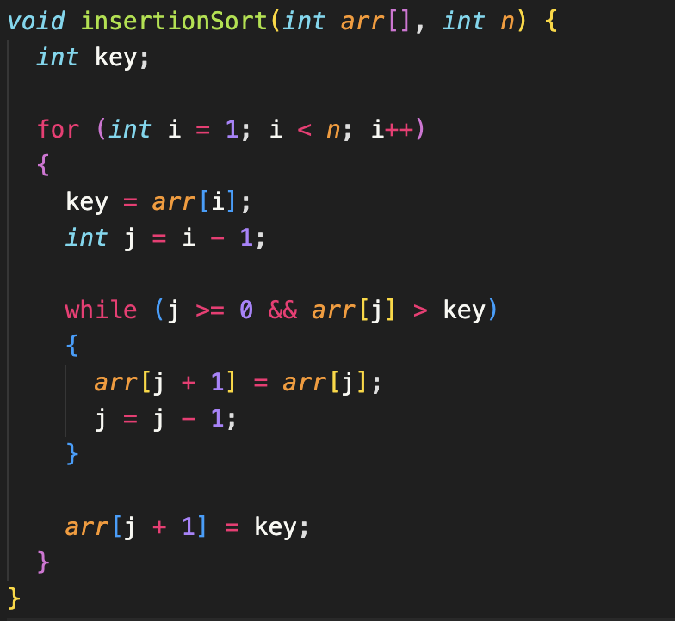
Insertion Sort Implementation

Slide 17
Insertion Sort Tracing
Manually sort the following array using Insertion Sort (show each pass):
[10, 3, 9, 7, 24, 2]
Pass 1: [3, 10, 9, 7, 24, 2]
Pass 4: [3, 7, 9, 10, 24, 2]
Pass 2: [3, 9, 10, 7, 24, 2]
Pass 5: [2, 3, 7, 9, 10]
Pass 3: [3, 7, 9, 10, 24, 2]

Slide 18
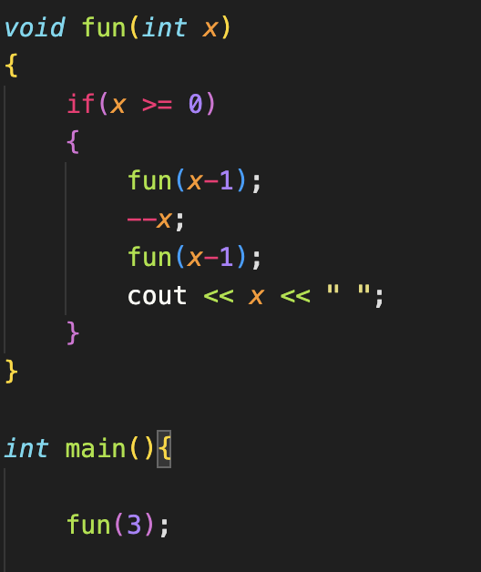
Recursive fun() Output
What does the following output?
TIP: Draw a recursive tree to follow the recursive calls easily
Answer:
-1, 0, -1, 1, -1, 0, 2

